Slide 1

How to Manage a Successful CAEP Accreditation Process: Best Practices – Lessons Learned
Brittiani L. McNeil, Ed.D.
Assistant Professor of Education
Ursuline College

Slide 2

Who am I?
Currently: Assistant Professor at Ursuline College (Cleveland, OH)
Previously:
  Accreditation Coordinator at John Carroll University (Cleveland, OH) (2012; 2015-2018; 2021-2022)
  Accreditation & Licensure Coordinator at Xavier University (Cincinnati, OH) (2018-2022)
15+ years of accreditation experience
  NCATE, CACREP, SPAs, CAEP, HLC
  CAEP Site Visitor
  State program review team chair

Slide 3
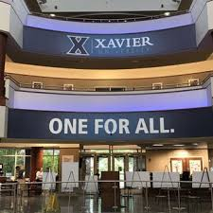
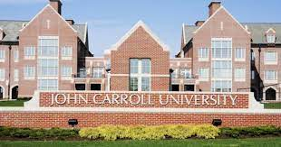
A Tale of Two Universities
John Carroll University, Cleveland OH
Received full accreditation of Initial Licensure programs in 2019; Advanced programs in 2022
0 AFIs or stipulations
First EPP in Ohio to receive the Frank Murray award
Xavier University, Cincinnati, OH
Received full accreditation of both Initial and Advanced programs in 2021
1 AFI for Initial Licensure

Slide 4
Best Practices

Slide 5

Build Your Roadmap
Have a layout of when accreditation activities are occurring semester by semester
  Include SPAs and any state reviews that may be applicable
Share the roadmap with your team
  TRANSPARENCY in the process

Slide 6
Roadmap Example
Fall 2023
Assessment review
Spring 2024
Spring 2025
Fall 2025
Spring 2026
Fall 2026
Spring 2027
Fall 2024
Site Visit!
Self-study submitted (Spring/ Summer)
FFR
Addendum
Site visit prep
State program review due
Data collection period
Data collection period
Data collection period (pilot new assessments)
Analyze pilot data, make changes if necessary
Start writing self-study
Self-study writing
Select site visit date
We are here!
Year 1
Year 2
Year 3

Slide 7
The Cover Letter
Arguably, one of the most important parts of the whole self-study
Necessary to give context to data, evidence, etc.
  Demonstrates how you use the information and what kind of changes have come from the evidence you intend to use
Nearly everything that you upload as evidence should have a cover letter

Slide 8
It Takes a Village
Rally the core team within the EPP
Faculty should be involved in the process
  Participation and buy-in
Brief/prep your stakeholders
  Alumni
  Current students
  Advisory board members
  Mentor teachers/supervisors
  K-12 partners
  Faculty
  University staff and leadership (i.e., admissions, Dean, Provost, etc.)

Slide 9

What’s Your Story?
Accreditation is like a jigsaw puzzle. Each piece comes together to tell a story

Slide 10
Lessons Learned

Slide 11
Standard 4
If ya got it, flaunt it!
  Ohio provides Value-Added, tracks completion of movement from resident license to professional license, surveys resident educators after year 1, some evaluation data (Metrics Reporting System)
If not, it is critical to build relationships with your soon-to-be completers
  Relying on surveys, focus groups, etc.
  If alumni feel connected to their preparation program, they will want to give back

Slide 12
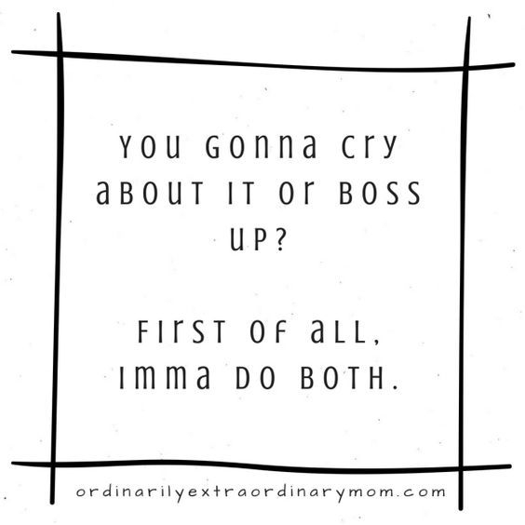
Embrace the Formative Feedback Report

Slide 13

The FFR
The FFR is the road map for the rest of your accreditation journey
Insights into what the review team is thinking/wanting to know more about
Chance to fix any issues they pointed out
Prep for your site visit

Slide 14

Ensure Ample Time for Uploading Into AIMS
Do this as soon as you have completed pieces of evidence
DO NOT wait until the day your self-study is due

Slide 15
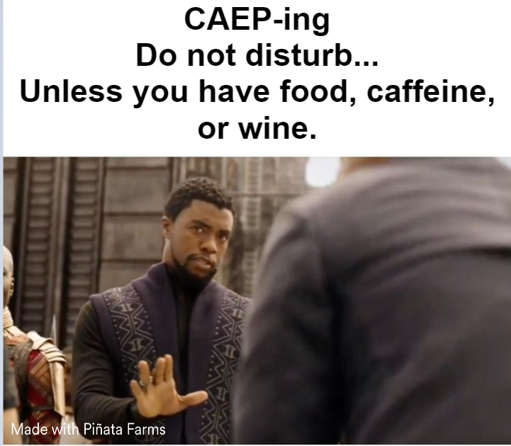
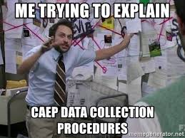
Have Fun and Maintain a Sense of Humor

Slide 16
Questions?
Please feel free to reach out:
Brittiani.mcneil@ursuline.edu
440-646-8147 (office)
440-296-3054 (text/cell)

Slide 17


